Slide 1
Final Project
Codecademy Data Analysis Project

Slide 2
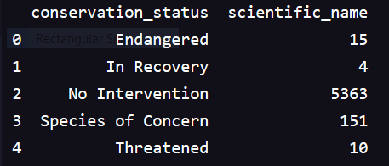
Levels of concern found in the dataset
None
Endangered
In Recovery
Species of Concern
Threatened

Slide 3
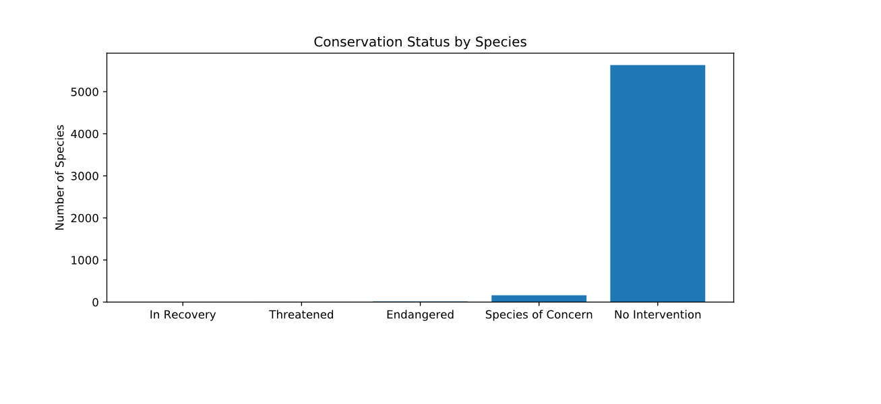

Slide 4
Suggestions for additional helpful data
Geographic range
Seasonal migration (where applicable)
Species in overpopulation
  Are some species crowding out species that we are concerned for?

Slide 5
Info found in species_info.csv
The species class (category)
  Animal kingdom represented
  Plant kingdom represented
The scientific name of the given species
  Latin
The Conservation status where indicated
  Overpopulation not indicated in data
The common name or names for the given species
  English only, presumed non-exhaustive

Slide 6
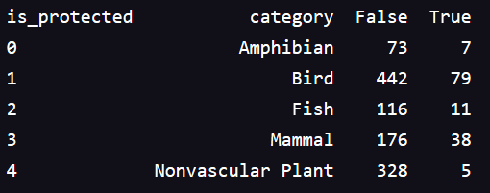
Current state of protection
At risk species are not likely to be protected.
  this may be an opportunity for increased protection depending on level of risk.

Slide 7
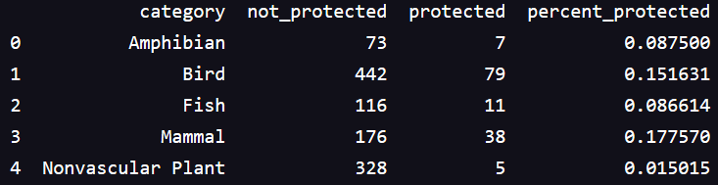
Protection by class
Of at risk species mammals are most likely to be protected.
  Why would this be?
    The social/commercial value of mammals over other species
    The ease of legislation and enforcement for a given species compared to another species. (beasts of the air, land, sea require distinctive protections)
    The resilience of a given species (high birth/reproductive rates)
    Lack of plan or prescription for protecting other species

Slide 8
Recommendations for conservation
Seek to develop better strategies to protect fish and birds.
Define pairs or sets of species that are at risk that could be protected simultaneously such as birds mammals and plants that work together to support each others existence.
For plants explore alternative environments that could support them.
  Plants are stationary and typically require specific climate ranges

Slide 9
Info about foot and mouth disease
Affects cloven Hoofed animals
Other animals are resistant or not affected.
Plants not affected.

Slide 10
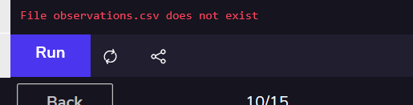
Difficulty with data
After many attempts to load the data including pulling it directly from my computer I was met with a message the data did not exist.
I did the best I could working around this problem.

Slide 11

Data about sheep
Searching for the scientific name ‘Ovis aries’ I returned the following observations
What is missing from the data is the
  size of the parks
  other species that may be susceptible to foot and mouth disease
  The range sheep may travel among the park and other species they may encounter

